Slide 1

Travel Recommendation System
Chandira Irina

Slide 2
Project Outline
Main Issue
Background
Data
Data Retrieval
Data Preparation
Model
Algorithm
Problem
Goal
Feature Engineering
Data Analytics and Visualization
Method

Slide 3

MAIN ISSUE
BACKGROUND 82% of millennials travelled last year, compared with 75% of all other generations (Source: https://www.condorferries.co.uk/millennials-travel-statistics-trends)
PROBLEM 2 in 3 millennials are interested in a service that provides surprise holiday recommendations based first on their personality, and second on their budget. (Source: https://www.siteminder.com/r/trends-advice/hotel-travel-industry-trends/millennials-travel-20-interesting-stats-millennial-hotel-guests/)
GOAL Increasing the conversion into bookings.

Slide 4

DATA: Data Retrieval
Travel Destination Data
Things To Do Data
Hotel and Flight Data
Spots Data

Slide 5
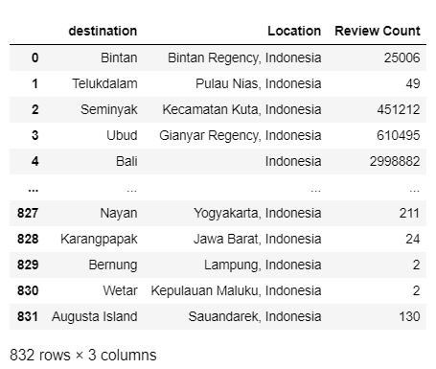

Travel Destination Data

Slide 6
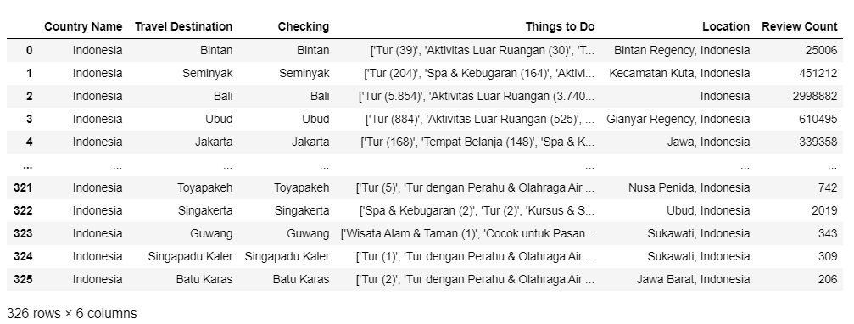

Things To Do Data

Slide 7

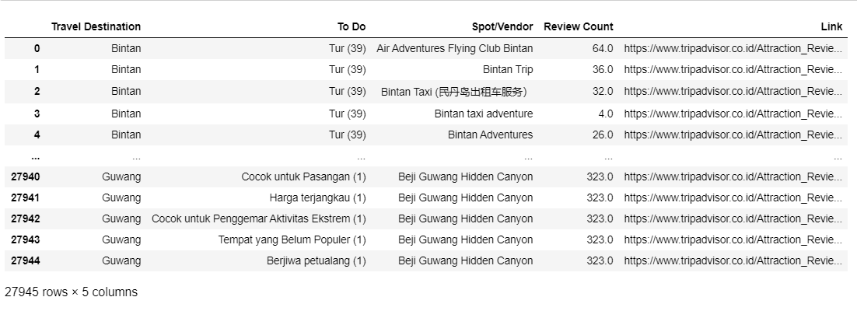
Spots Data

Slide 8
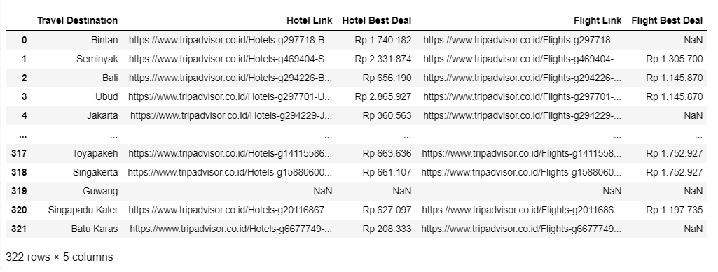

Hotel and Flight Data

Slide 9
DATA: Data Preparation and Handling Missing Values
Data preparation:
Formatting the data into suitable format
Handling missing values:
Checking back to the original data source
Handling missing values:
using mean values

Slide 10
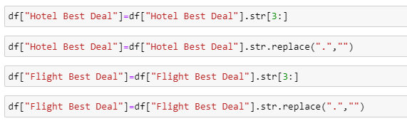
DATA: Data Preparation
Formatting the data into the suitable format, one of which by taking only the numbers out of the Hotel and Flight Price Data

Slide 11

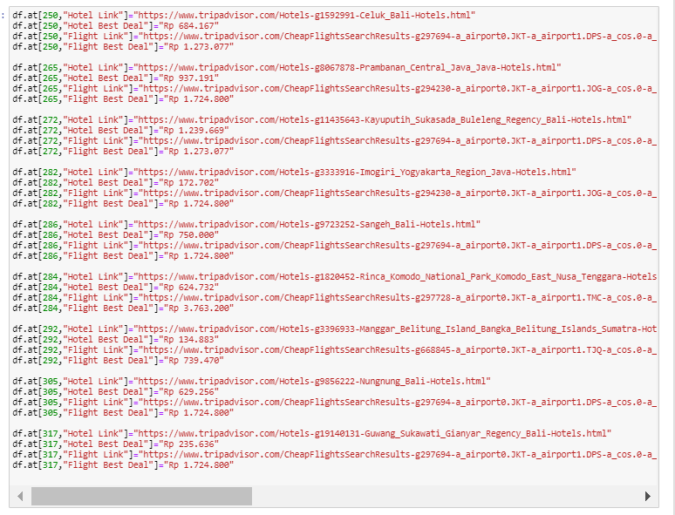
DATA: Handling Missing Data
Filing up Nan values manually by checking back to the original data source (Trip Advisor website)

Slide 12
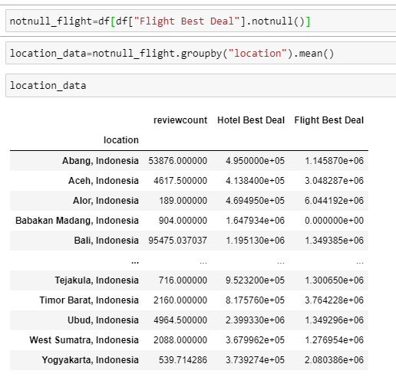
DATA: Handling Missing Data
Filling up NaN values using mean values of the similar region

Slide 13
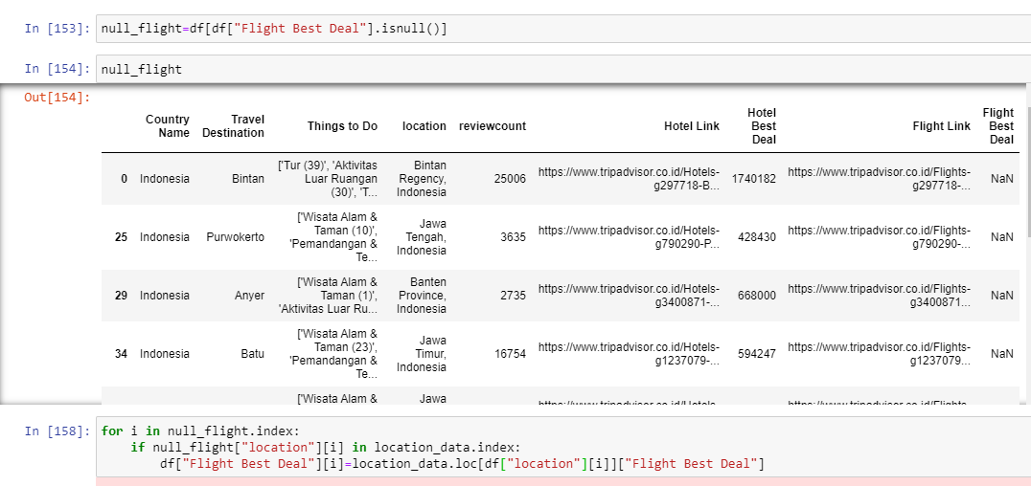
DATA: Handling Missing Data

Slide 14
DATA: Feature Engineering
Choosing the necessary features
Aggregating columns
DATA PREPARATION FOR Count vectorizer

Slide 15
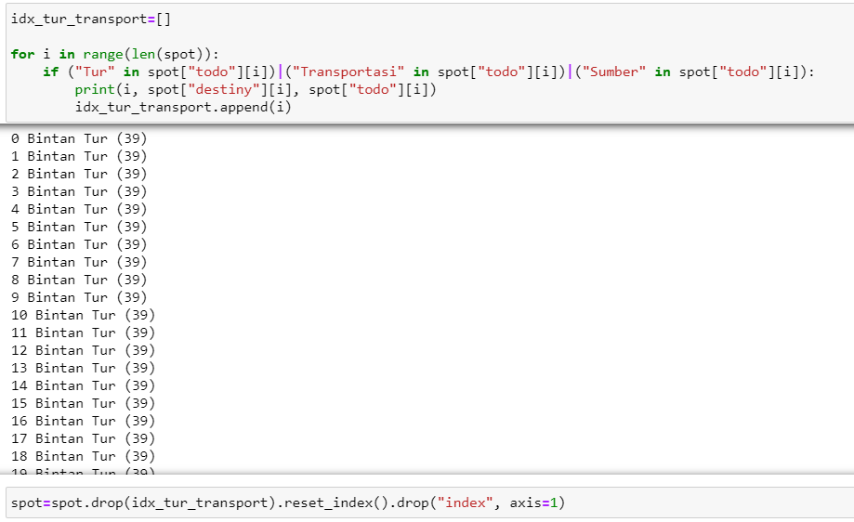
DATA: Feature Engineering - 1
Choosing only necessary features, by dropping “Tur”, “Transportasi”, and “Sumber Informasi Wisatawan”

Slide 16
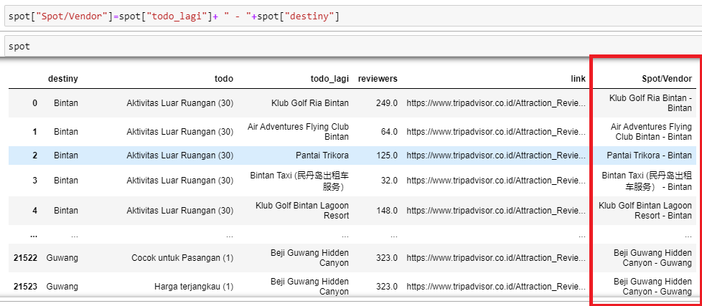
DATA: Feature Engineering - 2
Make a new column which is the aggregate of several other available data columns (in this case, combining two string-type columns to return Vendors name with its location)

Slide 17
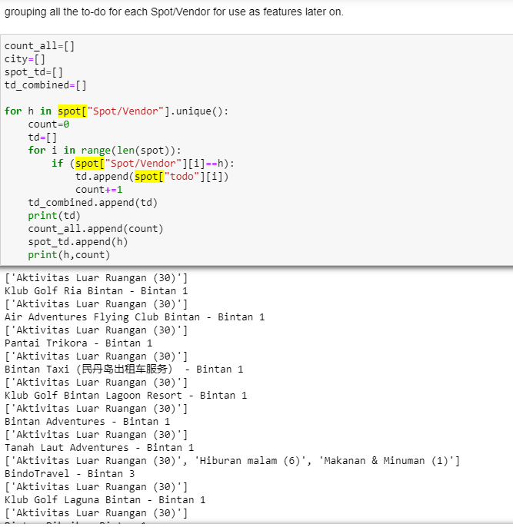

DATA: Feature Engineering - 2

Slide 18
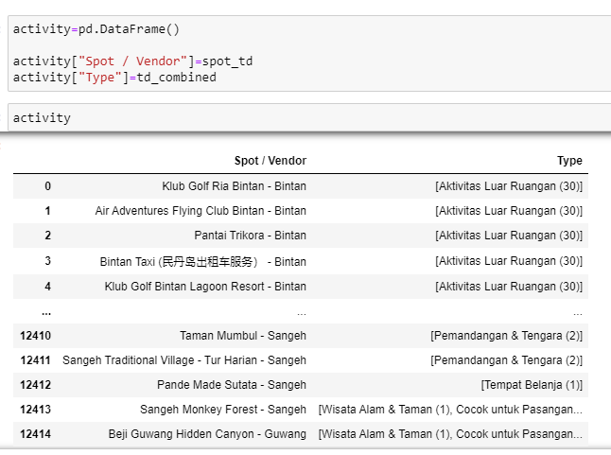
DATA: Feature Engineering - 2

Slide 19
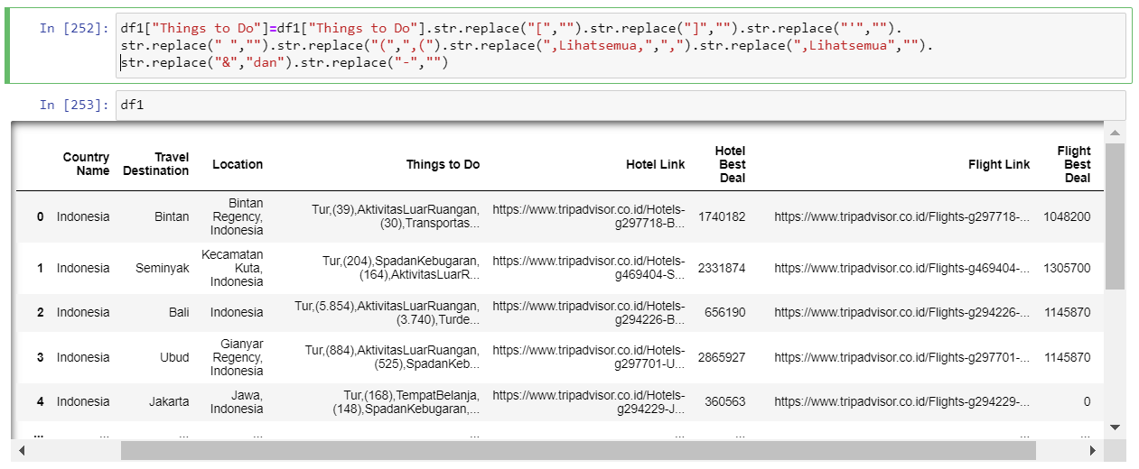
DATA: Feature Engineering - 3
Count Vectorizer needs the strings in a columns to be separated by space
(Refer to notebook Recsys : Pre-processing part)

Slide 20
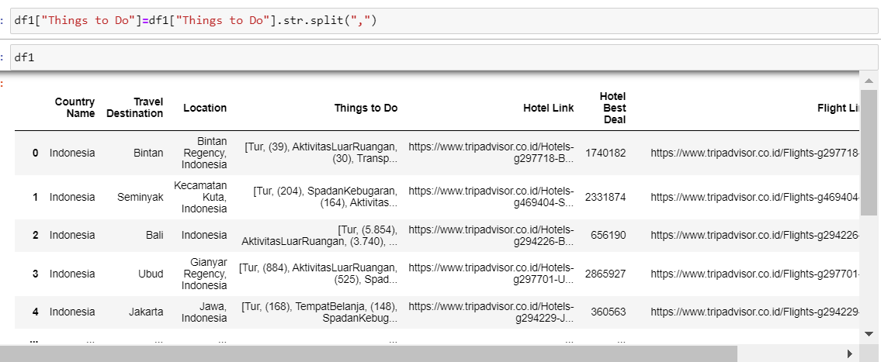
DATA: Feature Engineering - 3

Slide 21
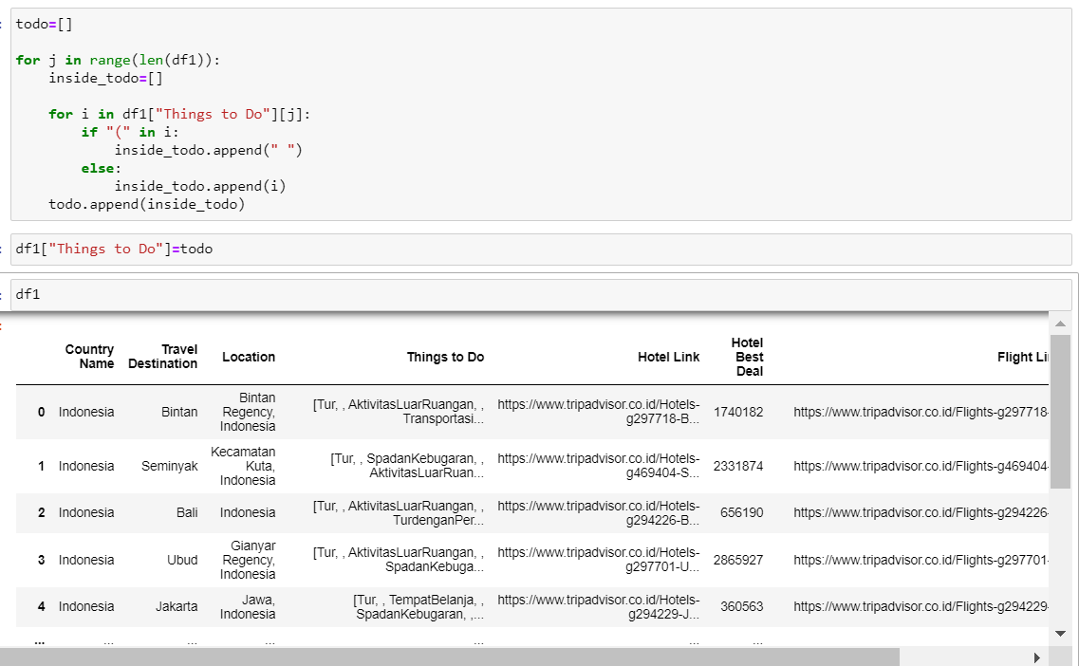
DATA: Feature Engineering - 3

Slide 22
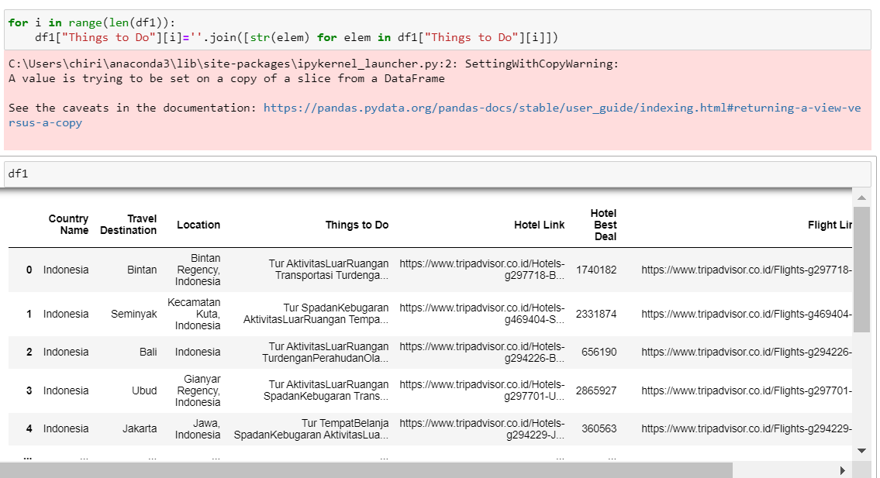
DATA: Feature Engineering - 3

Slide 23
DATA: Final Dataset
Dataset 1: information on travel destination with things to do, hotel, and flights thereof.
Dataset 2: information on spots in the travel destination with things to do thereof.

Slide 24
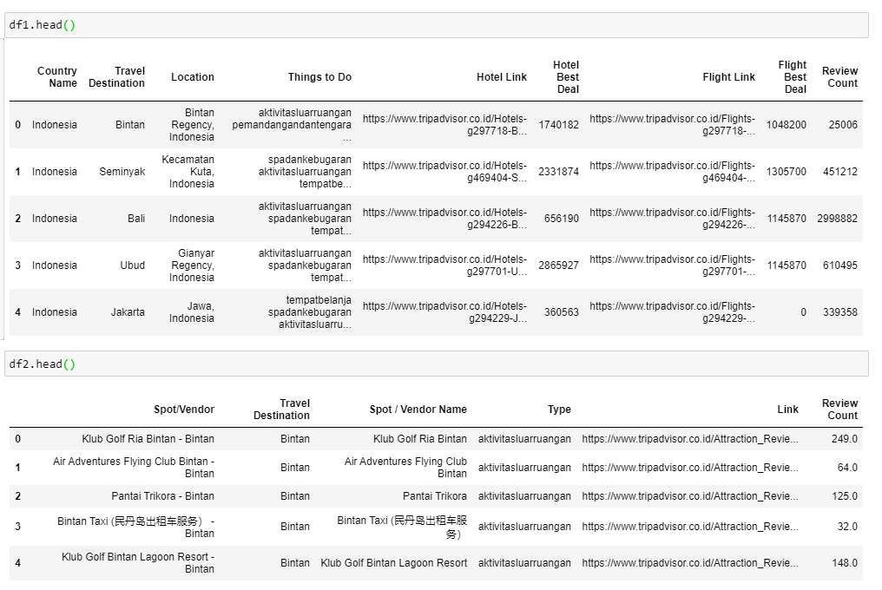
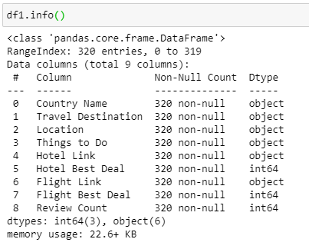
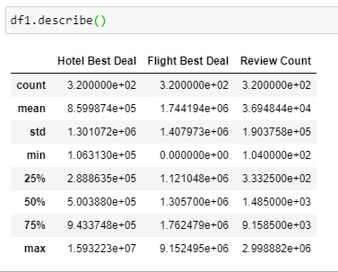
DATA: Final Dataset - 1

Slide 25
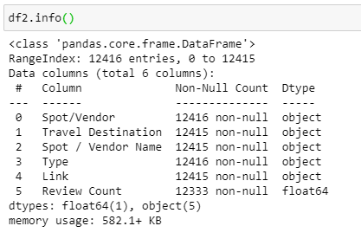
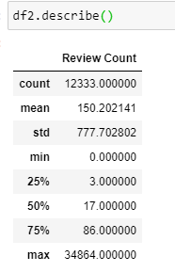
DATA: Final Dataset - 2

Slide 26
DATA: Data Analytics and Visualizations
Budgeting
Top destinations
Popularity distribution

Slide 27
DATA: Data Analytics and Visualizations - 1
How popular is travel destinations in Indonesia? Are their popularity normally distributed ? Are there a lot of popular destinations?

Slide 28
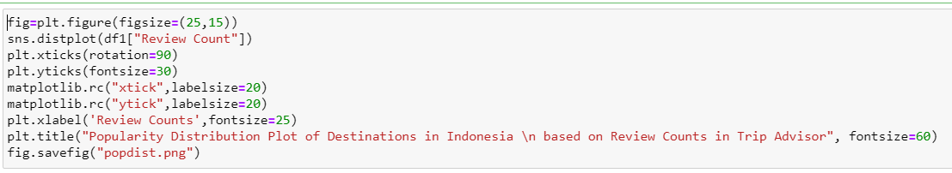
DATA: Data Analytics and Visualizations - 1

Slide 29
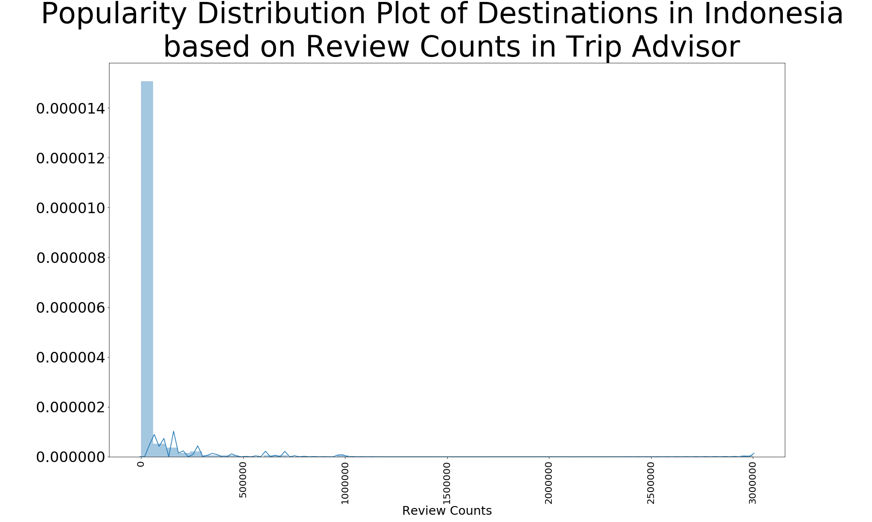
DATA: Data Analytics and Visualizations - 1

Slide 30
DATA: Data Analytics and Visualizations - 2
Which are the popular destinations in Indonesia? How popular are they?

Slide 31
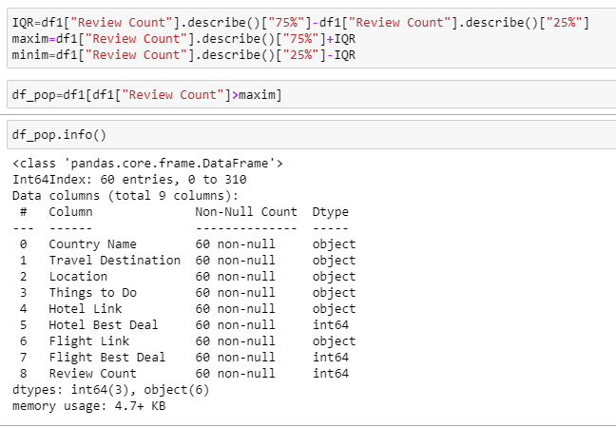
DATA: Data Analytics and Visualizations - 2

Slide 32
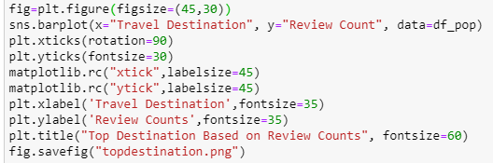
DATA: Data Analytics and Visualizations - 2

Slide 33
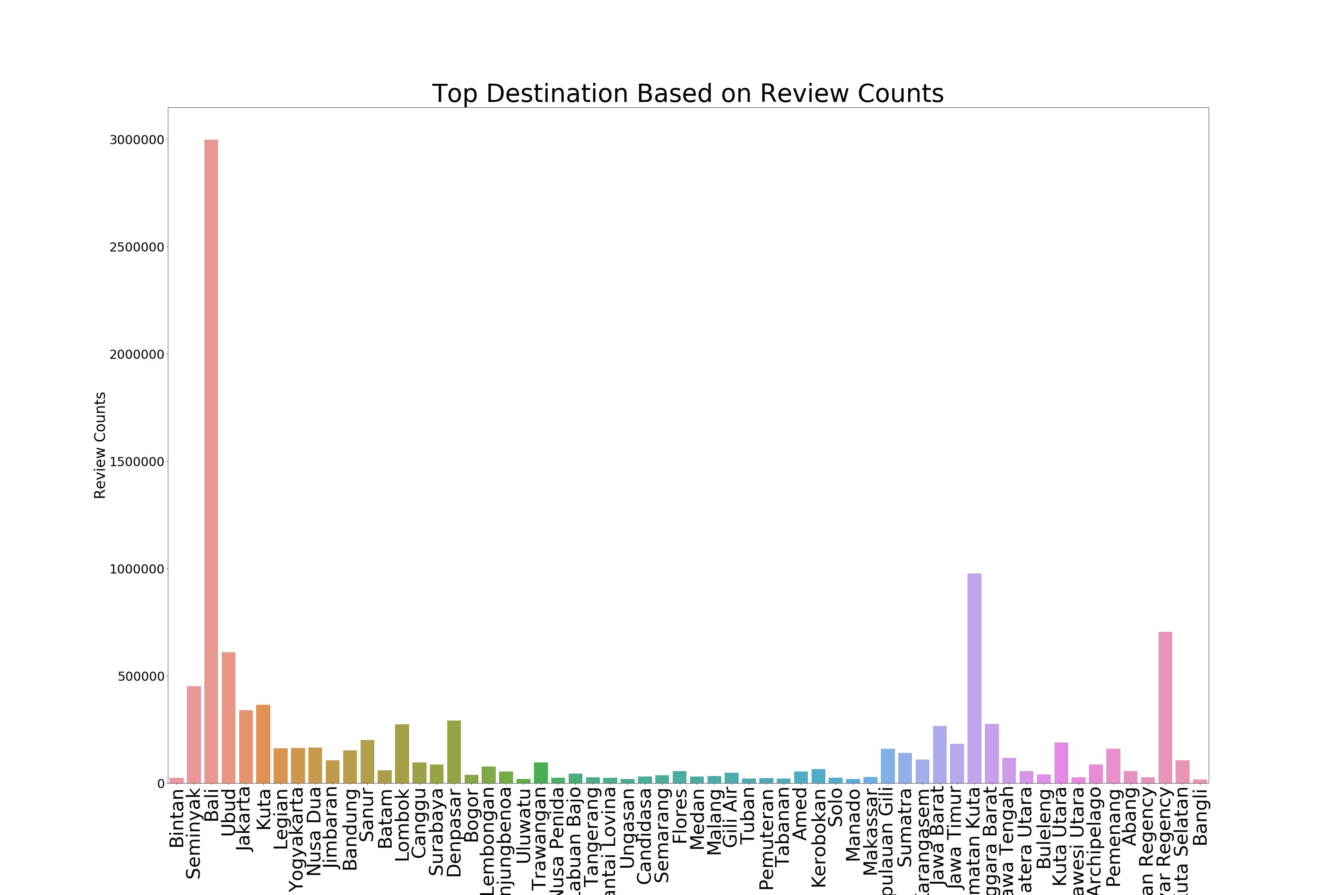
DATA: Data Analytics and Visualizations - 2

Slide 34
DATA: Data Analytics and Visualizations - 3
How is the flight and hotel budgeting for traveling to the top 10 destinations?

Slide 35
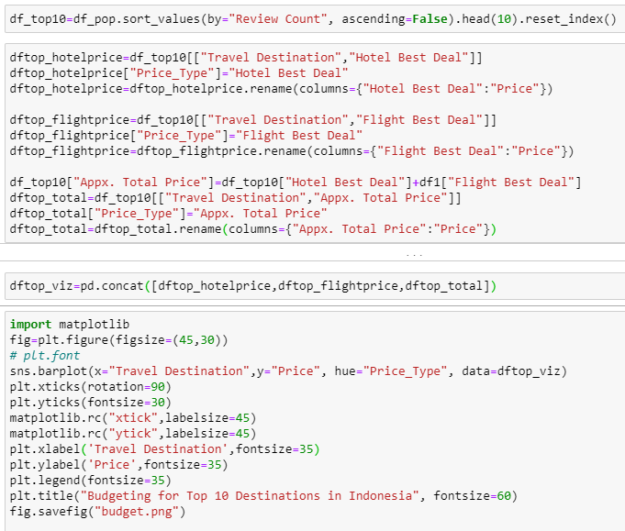
DATA: Data Analytics and Visualizations - 3

Slide 36
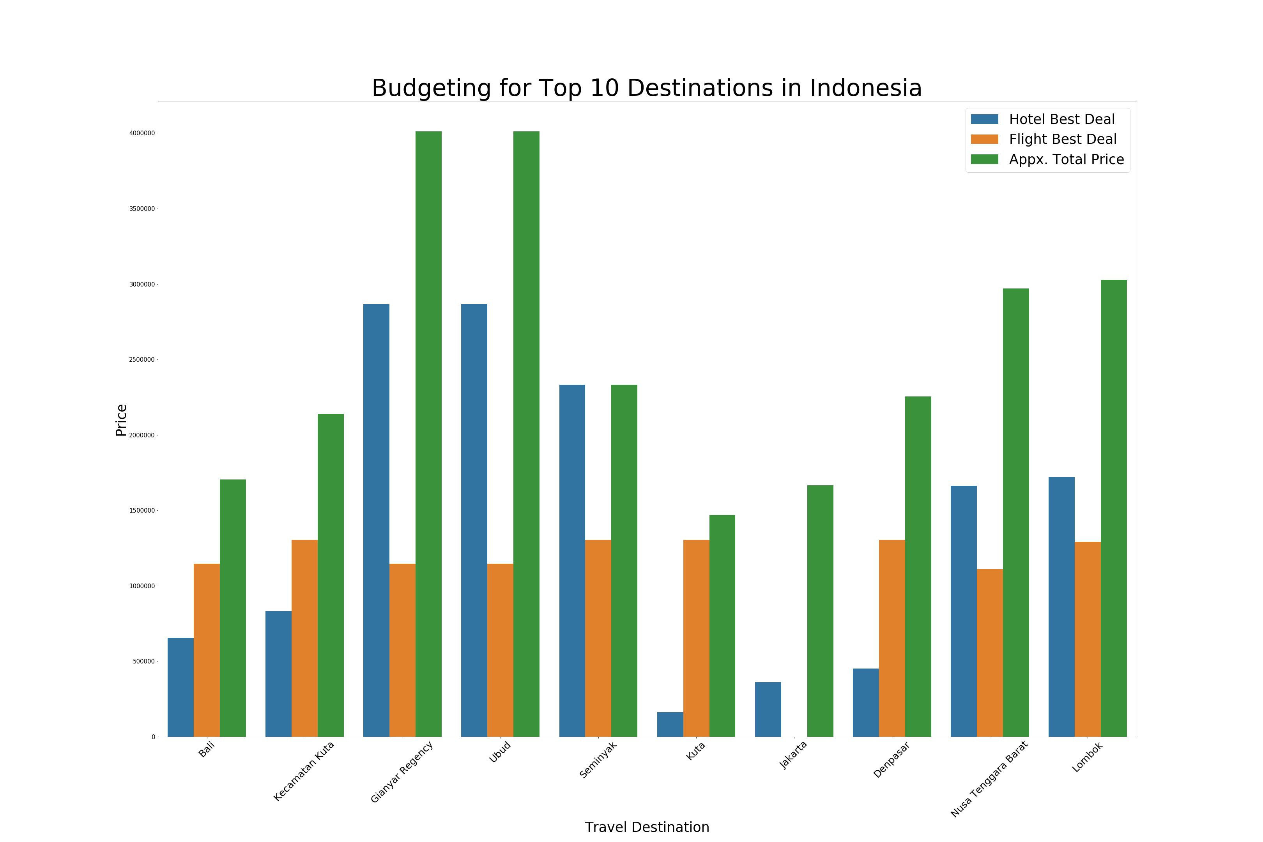
DATA: Data Analytics and Visualizations - 3

Slide 37


MODEL
Content-based recommendation system
- cosine similarity
- JACCARD SIMILARITY
- Spearman correlation

Slide 38
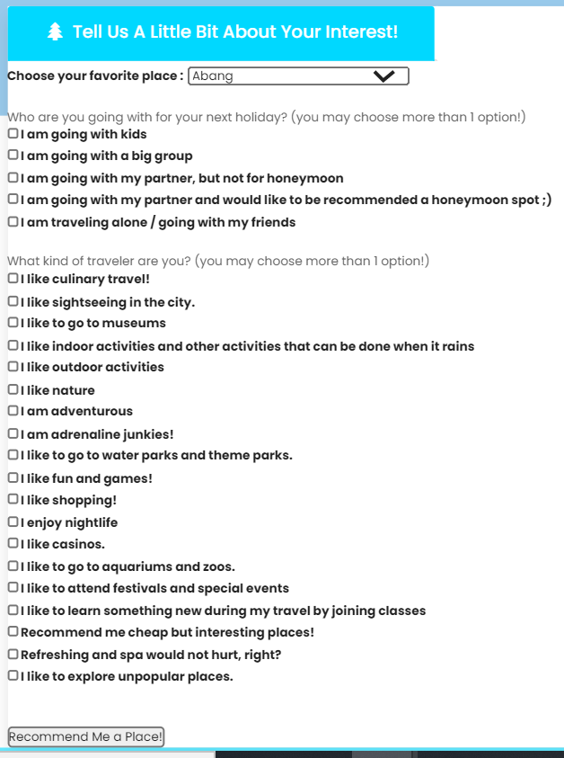
User input page

Slide 39

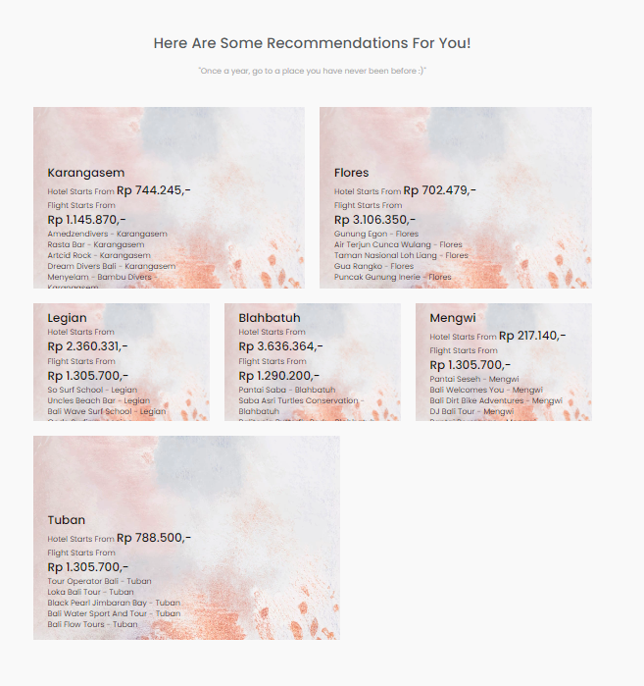
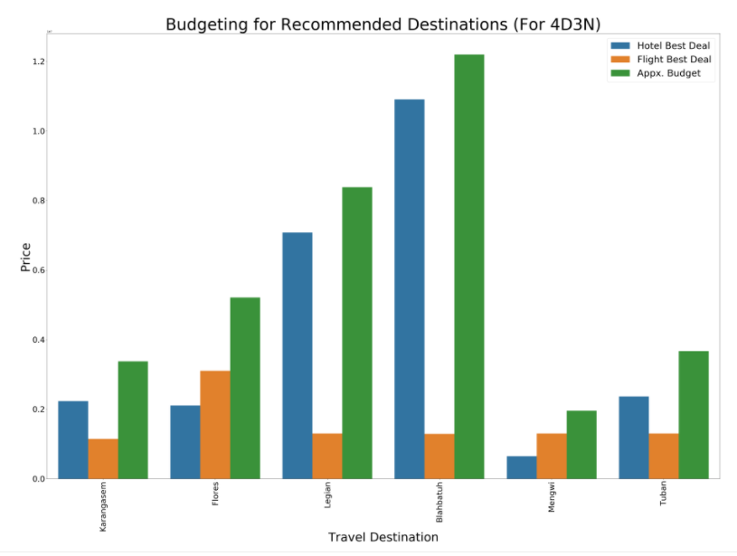
Recommendation page

Slide 40
CONCLUSION
it is very important to understand domain knowledge in the process of data analysis in order to handle the missing data and choose the suitable features for modeling.
evaluatioin in recommendation system is online evaluation, which means the model needs to go online first before we can judge its effectiveness.
The current system can be enhanced by getting more information regarding the activities available in each destinations and spots.
Adding more features into the model may also be useful, such as hotel and flight preferences.

Slide 41
THANK YOU

